Slide 1
WARNING!!! WARNING!!!
ABSTRACT IN YOUR PROGRAM SHOULD READ:
O10a. The Evolving Role of Child Maltreatment Risk in the Contexts of Service Triage, Delivery and Research
﻿﻿David Bard﻿, sponsored by Center for Child Abuse and Neglect, University of Oklahoma Health Sciences Center
Description
We closely examine the concept of risk and its implications on treatment and surveillance of maltreatment. Core concepts range from frontline triage decisions, to client-centered tailoring of treatment, to new frontiers of measurement.
Learning Objectives
Review risk classification as a triage tool rather than an enrollment strategy.
Introduce risk-informed adaptive treatment strategies for primary and secondary care settings.
Propose new measurement frontier for assessment of maltreatment risk.

Slide 2

Evolving Role of Child Maltreatment Risk in the Contexts of Service Triage, Delivery, and Research: A Snapshot of Oklahoma’s Implementation Research and Evaluation
David Bard, PhD
University of Oklahoma HSC
Center on Child Abuse and Neglect

Slide 3
Conflict of Interest Disclosure
Under Accreditation Council for Continuing Medical Education guidelines disclosure must be made regarding financial relationships with commercial interests within the last 12 months.
David Bard
Grants/Research Support from:
DHHS HRSA and ACF D89MC23154
OUHSC CCAN Independent Evaluation of the State of Oklahoma Competitive MIECHV Evidence-Based Home Visitation Project
Children’s Bureau 90CA1764
Evidence-Based Child Maltreatment Prevention for High Risk Families: Expanding to Latino Communities, Enhancing Family Violence Prevention and Sustaining Programs
OKDHS OJJDP2006JPFX0067
Prevention of Child Maltreatment in High Risk Urban and Rural Oklahoma Families
CDC 1R18CE001334-01
Cascading Diffusion of an Evidence-Based Child Maltreatment
Consultant from: Casey Family Studies
Stock Shareholder from: None
Honorarium from: Casey Family Studies
Other Financial or Material Support from: None

Slide 4
Overview of Presentation
Theme: State-of-the-Art Study Designs for Evaluating Home-Visitation Programs
Appropriate client triage
Adaptive HV services (meeting individual client needs)
State-of-the-System Address on Measurement of Outcomes and Risk Factors
Where we’ve been (history of risk factor research)
Where we are now (expected risk factor covariates)
Where we might be headed (need for new measurement methods and better prediction)

Slide 5
Incorporating Triage Decisions into Home Visitation Research

Slide 6
Desire and Need for Triaged HV Services
Problem
Typically client risk is assessed at intake and “silo” services decisions are made
If client risk does not meet service threshold, services may not be obtained
Solution
As the spectrum of HV services continue to grow, more sophisticated triage systems could be developed to connect families to the most suitable services

Slide 7
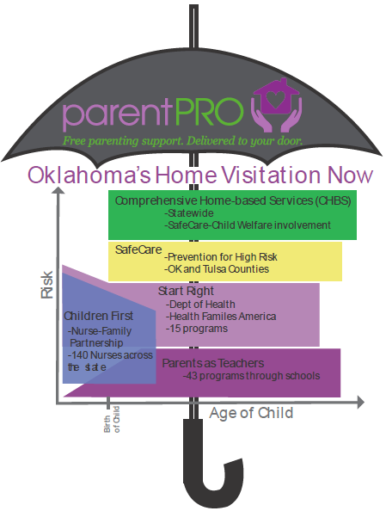
Evolving HV Continuum in Oklahoma

Slide 8
Case Study Example Of Triage Built into a Research Study
Evidence-Based Child Maltreatment Prevention for High Risk Families: Expanding to Latino Communities, Enhancing Family Violence Prevention and Sustaining Programs (Children’s Bureau 90CA1764)
Two studies really
Latino expansion RCT
Urban process RCT

Slide 9
Latino Agency Trial Specifics
Local Latino community mental health service agency
Currently offered low-risk HV prevention services
High-risk families referred elsewhere
Primary Research Aims
Evaluate effectiveness of a high-risk HV prevention service, SafeCare® Plus, in a Latino population

Slide 10

Research/Practice Quandary
Possible solutions
Find another high-level comparison treatment
Scratch scientific rigor of RCT and opt for non-randomized, quasi-experimental comparison
OR, regression discontinuity
ETHICAL STANDARDS
SCIENTIFIC STANDARDS

Slide 11
Regression Discontinuity Designs
Preserves unbiasedness of treatment effect comparison provided the assignment mechanism is fully known (Rubin, 1977; Shadish, Cook, & Campbell, 2002)
Still not sold… What if we threw in a small RCT to go along with it?
Hybrid (randomized cutoff) design uses two scoring thresholds for assignment
Divide the assignment score into 3 segments: 1) low scores assigned to A; 2) middle scores randomized to A or B; 3) high scores assigned to B

Slide 12
Testing the Treatment Effectiveness Hypothesis
Null hypothesis still reflects 'no difference' between treatments being compared
Tests of this hypothesis do differ, however!
Simple ANCOVA intercept difference works when known relationship exists between assignment score and the outcome and scores do not interact with size of treatment effect

Slide 13
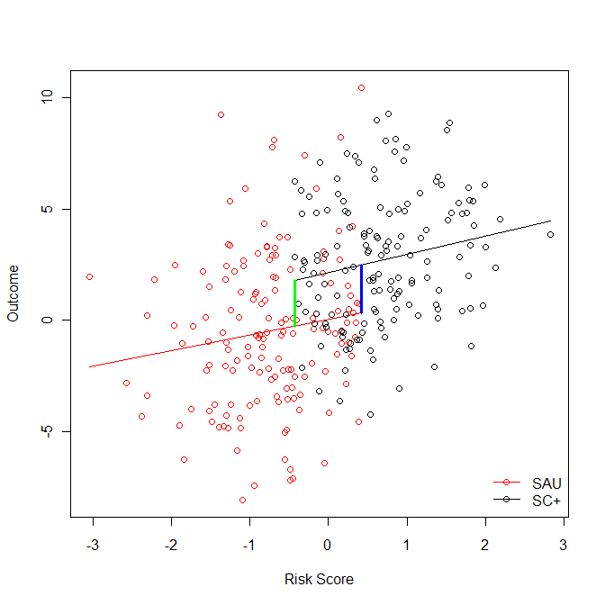
ANCOVA Example for Local Treatment Effect

Slide 14
Not So Simple Treatment Comparisons
If interaction between score and treatment impact…
Divide Null hypothesis into 2 or more separate hypotheses (e.g., 1 per threshold)
Average Causal Effect still viable in middle segment of hybrid design
Report continuous interaction effect (be wary of effect extrapolations below the first threshold)
Include historical control/comparison group

Slide 15
Nonlinear Outcome-Risk Relationships in Maltreatment Research
Unbiasedness of local treatment effect still holds as long as relationship between risk score and outcome is known in advance
For our context, develop a risk score using archival data; relationship between risk score and outcome cross-validated across similar samples
“The primary mission of child welfare agencies is to effectively manage the risk of child maltreatment and actuarial risk assessment can help agencies target scarce service interventions to children at the greatest risk of harm.” Shlonsky, A., & Wagner, D., (2005).

Slide 16
Developing an Assignment Risk Score
Three separate datasets:
1 Test sample (subset of Tulsa agency eval dataset) (N=958)
3 Validation samples
Non-Hispanic clients from OK secondary prevention HV eval (N=940)
Hispanic clients from OK secondary prevention HV eval (N=167)
All participants from OUHSC effectiveness trial of SafeCare® (N=501)
Regression tree scoring algorithm available in the RPART recursive partitioning package of R (Therneau & Atkinson, 1997)
Event times transformed to cumulative hazard estimates
Poisson process model version of exponential hazard regression performed on transformed times and censoring variable
Sequential tree splitting determined by improvements to Poisson deviance

Slide 17
Regression Tree Scoring Approach
Justification: Develop a risk scoring algorithm that was both
substantively meaningful (i.e., congruence with prior maltreatment prediction models)
Required minimal inputs and could be scored simply and quickly (ala Apgar score)
Allowed for potential complexities like interactions without greatly overcomplicating scoring procedure
10 covariates allowed to predict event histories
1) Brief CAPI risk; 2) poverty; 3) any drug use, including prescription drugs (meds); 4) single parent families; 5) cigarette use; 6) parental age; 7) housing instability; 8) depression risk; 9) substance abuse risk; and 10) prior domestic violence.

Slide 18
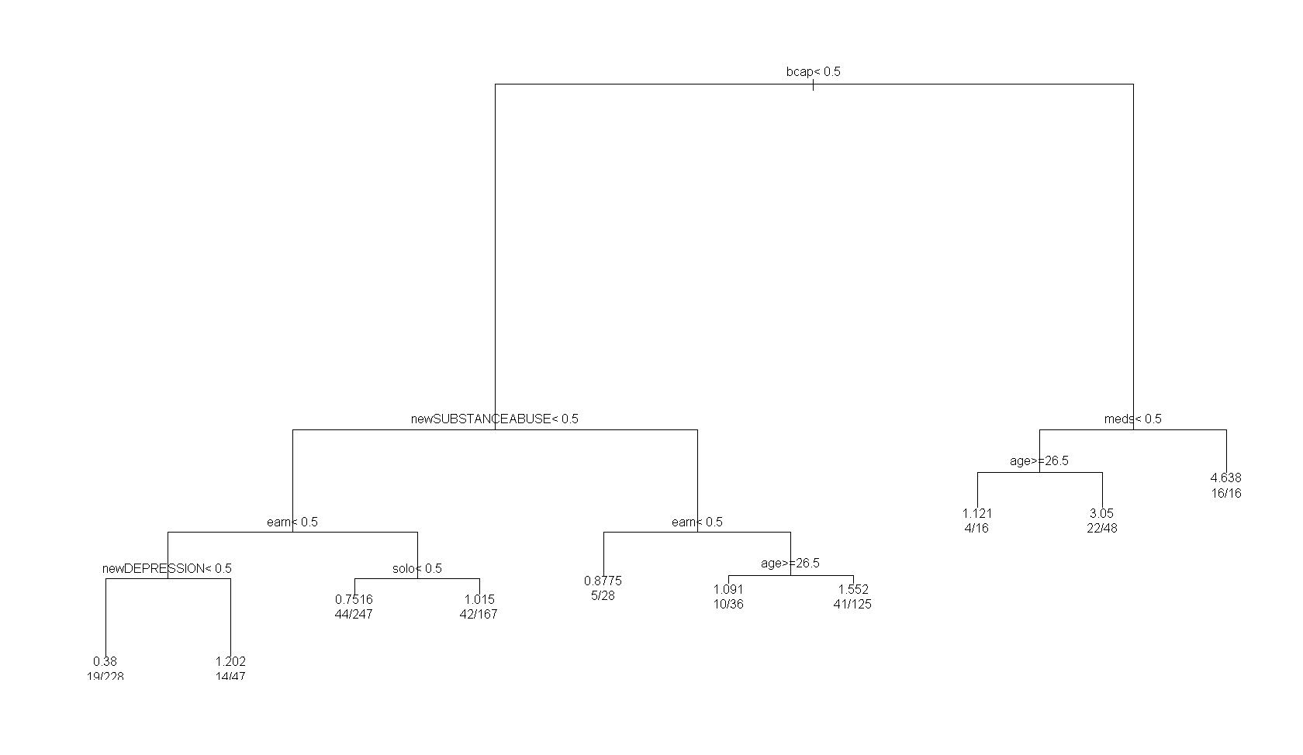
RPART Scoring Tree

Slide 19
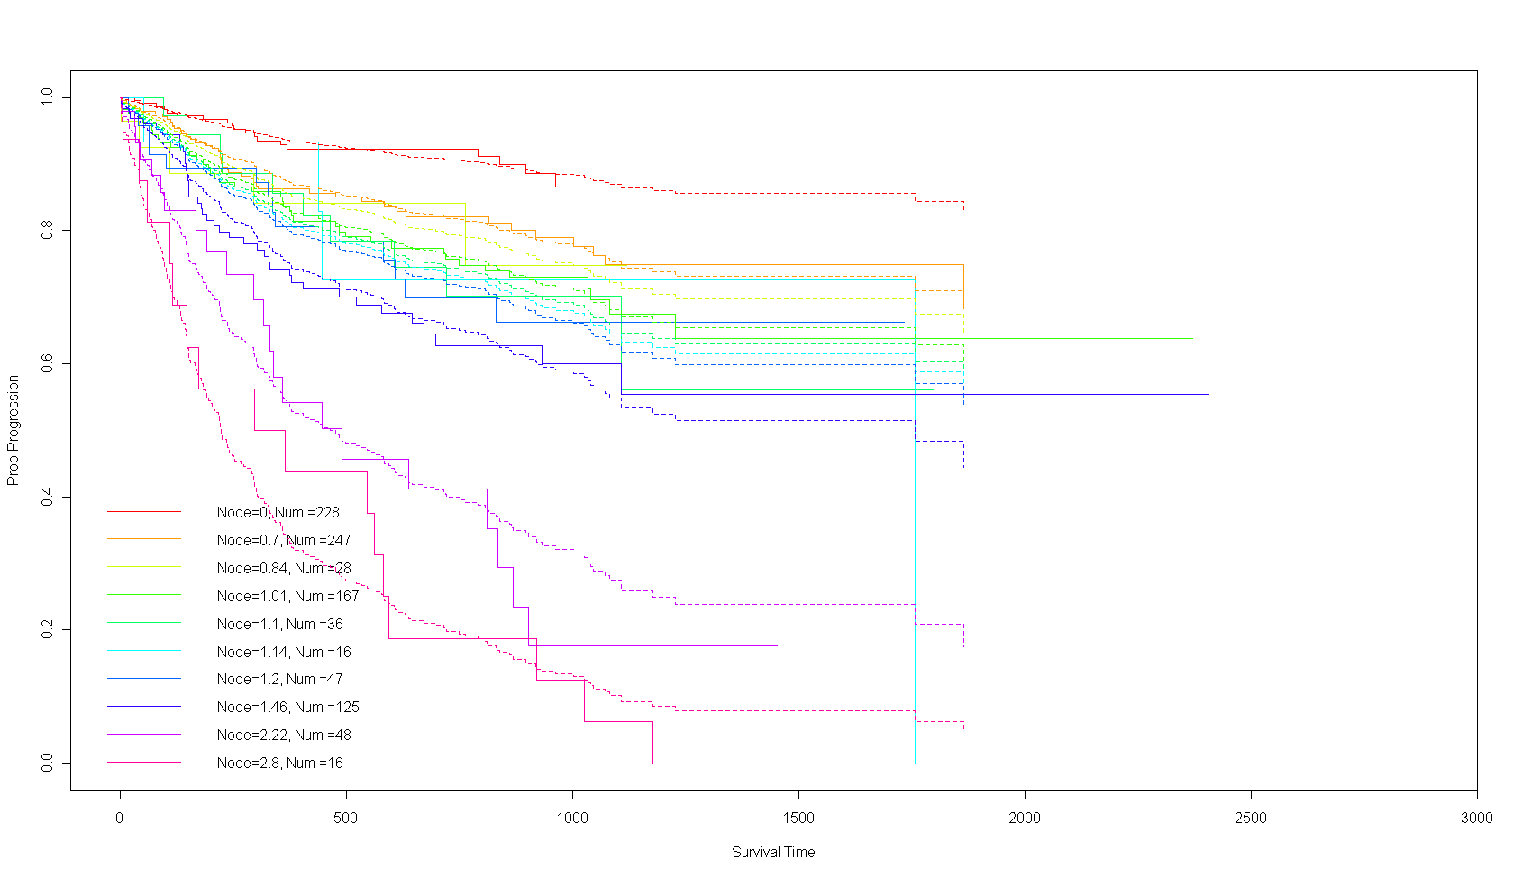
RPART Score Fit in Test Sample

Slide 20
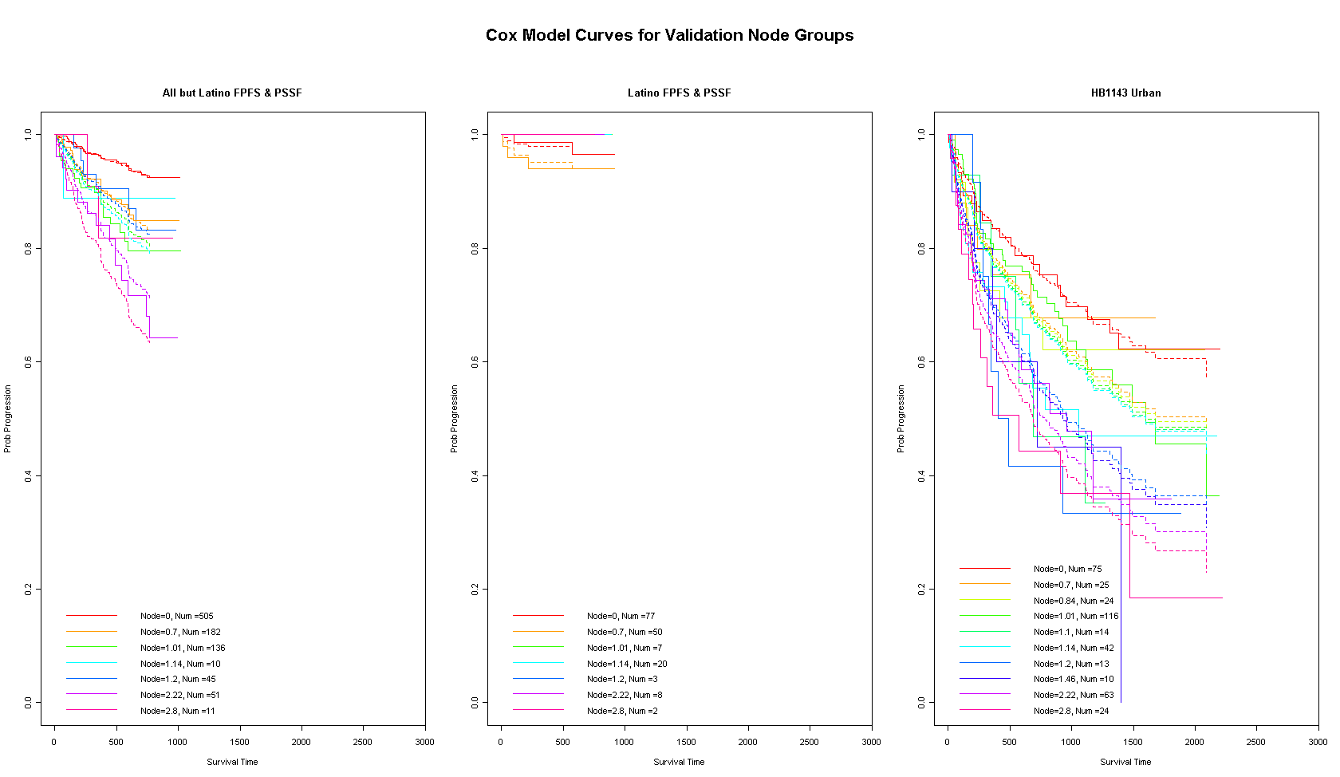
RPART Score Fit in Validation Samples

Slide 21
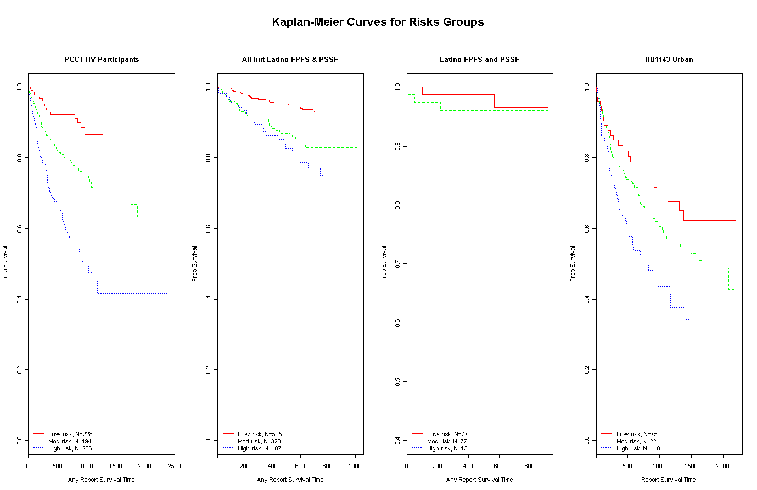
RPART Score Fit in Test and Validation Samples

Slide 22
Summary of Method and Work
Advantages of Regression Discontinuity and Hybrid RD/RCT designs
Good balance of ethical concerns of treatment match and rigor of scientific investigation
Limitations of Design
Weakened statistical power
Must have good a priori knowledge of risk-outcome prediction curve shape
Risk score now available for those wishing to incorporate triage decisions into designs for HV effectiveness research

Slide 23
Adaptive Treatments in Home Visitation Research
Notes:
The idea of triaging individuals to the most appropriate level of services can also be extended to the individual programs selected for a family. For a few of the existing HV models, this type of service adaptation is within reach and worthy of further pursuit.

Slide 24
Multi-Dimensionality of Client Risk
Major subtypes of maltreatment
Can we predict prospective subtype incidence?
Assuming we can predict risk, efficacy for adaptive treatments?
Desire for such systems parallel patient-centered care emphasis in medicine (Eddy et al., 2011)

Slide 25
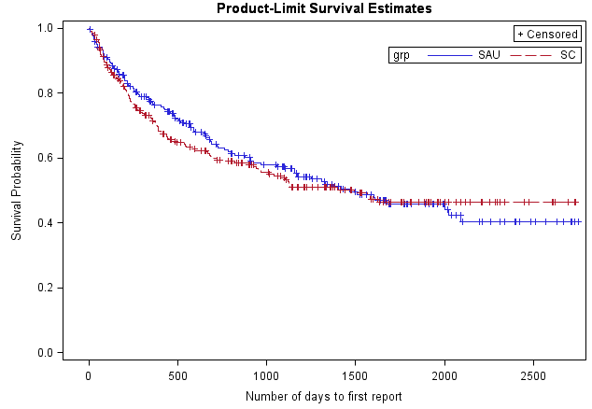
Why bother?
Current system failures- particularly those occurring early in treatment

Slide 26
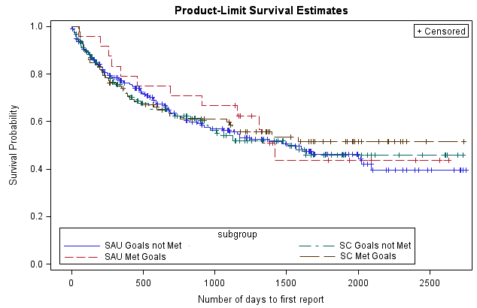
Explained by Service Compliance?
Current system failures- even among those reaching service goals (n=93)

Slide 27
Predictions of Future Abuse and Neglect Subtypes
Past work
Relatively good at predicting any future CPS involvement
Multiple failures when trying to predict future subtypes

Slide 28
Adaptive Treatment: Order and Dose/Intensity Implications
Order-Matters?
Concept: Order of SafeCare module exposure can matter when immediate risks areas are not addressed early in treatment
Less-is-More?
Concept: Which is more important, depth of coverage or breadth of coverage?
Augmentation of SafeCare
Discipline module
Partner and family violence module

Slide 29
Small-Scale Design of Less-Is-More and Order-Matters Adaptions to SafeCare®
Table 1. The 2² Factorial Design Matrix
 | Consumer-Driven | Data- Driven
PD+4 | n=100 | n=100
PD+1 | n=100 | n=100

Slide 30
Where to Next? New Frontiers in Risk Profile Measurement

Slide 31
“Measurement Is Not Sexy!”
But, yet, it’s crucial!
Sin qua non
Without measurement we have no “evidence-base”
All that glitters is not gold
Unreliable measurement is fool’s gold
Surrogate measurement often amounts to the same
Notes:
No two measures are alike (this should worry us more)
The list of cautionary tales regarding use of surrogate measures continues to grow

Slide 32
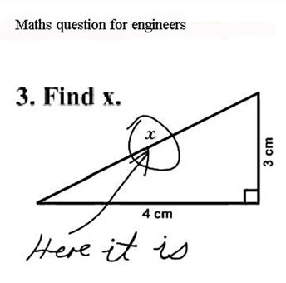
“If it ain’t broke, don’t fix it.”
But are we measuring from all the right angles?

Slide 33
Measurements Short-comings in Maltreatment Research
Outcome Measurement
Self-reported potential
Provider-reported potential
Maltreatment reporting
Fuzzy measurement and power of detection
Reliability and validity concerns (Are You Sure panel discussions)
Risk Factor Measurement
Maltreatment Subtype Prediction Failures
Very few are expected to predict subtypes b/c they are global/generic constructs (depression, demographic indicators)
Self-report or Provider-report rating scales (Scaling individuals only; e.g., Likert-like response scales)
Sexiness quotients aside, to advance the science, measurement needs to be (re)addressed!!!
Notes:
demographic- age, income, number of children, etc., biographic- prior abuse history, prior CPS involvement, etc., and indirectly related psychosocial measures- depression, social support, etc., to predict risk

Slide 34
CCAN Subtype Prediction Model Summaries: Environmental Neglect

Slide 35
CCAN Subtype Prediction Model Summaries: Medical Neglect

Slide 36
CCAN Subtype Prediction Model Summaries: IPV

Slide 37
Decision-Theoretic Approaches to Measurement
“Vividness” and emotional aspects of future decision-making
Multi-dimensionality of Risk Revisited: Risk Perception vs. Risk Attitude
Scaling individuals and stimuli (attributes) based on preferential-choice tasks
Digging deep into the meaning of unit of measurement and assumptions of interval scaling
Notes:
IMHO, most promising advances in measurement within the social sciences belong to the judgment and decision-making scientists. And there are some very relevant, exciting developments happening in that field that few applied researchers have yet to take advantage of.

Slide 38
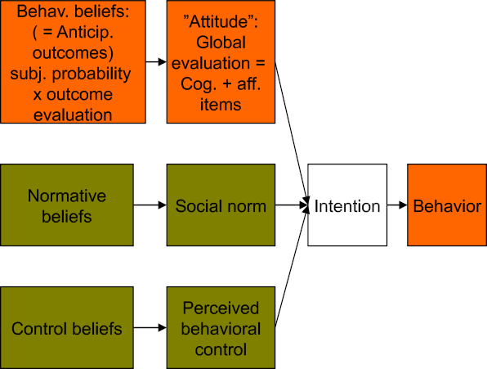
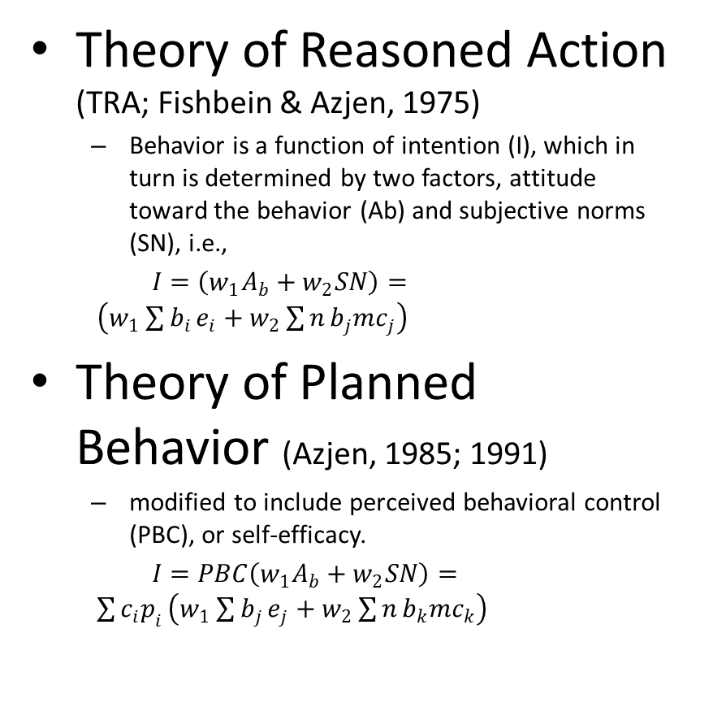
There is Precedent Health Behavioral Decision Theory
Theory of Reasoned Action (TRA; Fishbein & Azjen, 1975)
Behavior is a function of intention (I), which in turn is determined by two factors, attitude toward the behavior (Ab) and subjective norms (SN), i.e.,
$I=\left(w_{1}A_{b}+w_{2}SN\right)= \left(w_{1}\sum{b_{i}}e_{i}+w_{2}\sum{n}b_{j}{mc}_{j}\right)$
Theory of Planned Behavior (Azjen, 1985; 1991)
modified to include perceived behavioral control (PBC), or self-efficacy.
$I=PBC\left(w_{1}A_{b}+w_{2}SN\right)= \sum{c_{i}p_{i}}\left(w_{1}\sum{b_{j}}e_{j}+w_{2}\sum{n}b_{k}{mc}_{k}\right)$
Notes:
There is a precedent for ideas from decision science seeping into health behavior research, even child maltreatment research. The two most popular uses of decision theory in these fields are TRA and TPB.
where w1 and w2 are weights; A_{b} is a function of a person's beliefs (b_{i}) and evaluations (e_{i}) for
certain outcomes, and SN is a function of a person's beliefs about social norms (nb_{j}) and his
motivation (mc_{j}) to comply with them. The mathematical form for attitude toward a behavior (A_{b}) of the TRA is the same as [Subjective Expected Utility Theory] where beliefs are equivalent to subjective probability and evaluations to desirability.
The new version is called the theory of planned behavior (Ajzen, 1985, 1991). Using the same notation as above, the theory of planned behavior states that PBC interacts multiplicatively with intention, i.e.,

Slide 39
Precedent for Cognitive Behavioral Theory and Treatments for Abuse
Parental cognitions shape behavior and emotions toward child (Azar, 1997, 1998; Milner, 2000)
Social Information Processing Theory (Milner, 1993, 2000)
Stages of cognitive evaluations leading up to physical aggression
Initial perception and allocate attention resources
Gathering of expectations and processing perceptual stimuli
Integrate information and output behavior reactions
Selection of behavioral response and cognitively monitor/manage resulting outcomes
Examples of SIP risk factors
Locus of control
Developmental expectations

Slide 40
The Old and the New
Anticipated outcomes
Cognitive evaluation
Decision/ Behavior
Outcome
Subjective probabilities
The Old Consequentialist Model
Feelings
Anticipated outcomes
Cognitive evaluation
Decision/ Behavior
Outcomes (incl. emotions)
Subjective probabilities
Feelings
The New Dual Process Model
Other factors e.g., vividness, immediacy, background mood
Notes:
SIP (from last slide) is a wonderful model and is actually teetering on the dividing line illustrated here between the old and the new cognitive DM models (mention SIP measuring constructs like frustration tolerance and empathy, but disappointment with their limited use and the ways they have been used- horse race regression fixed effects- no interactions, no subject-specific differentiation)
Loewenstein et al. (2001) are among the many that now suggest models incorporating both of these influences could overcome many of the pitfalls of traditional normative consequentialist decision theories. As Figure 1 depicts, the addition of emotions to anticipated outcomes (expected emotions are derived from the integration of anticipated emotions and their associated subjective probabilities of occurrence) and the inclusion of immediate emotions (feelings in Figure 1b) leads to a dual process influence on behavior.
Loewentstein et al. (2001) argue that previous judgment and decision-making (J/DM) studies have all too often focused on the influence of expected emotions on choice and behavior through the analytic system. Yet, rarely, if ever, are real world decisions devoid of any influences from immediate emotions via the experiential system.
Despite this change, the current proposal will focus on the effects of affect, both immediate and expected, on behavior via the analytic system. Future studies are planned for exploring the experiential system influence.

Slide 41
Dual Process Health Behavior Decision Theories?
Primacy of cognition fatally flawed in risky decision making contexts?
New dual process theories beginning to emerge
Prototype Willingness Model (Gerrard et al., 2008)

Slide 42
The Prototype Willingness Model
First basic assumption: health risk behavior is usually volitional, but not often planned or intentional.
Adolescents continue to deny intentions to engage in risky behaviors despite repeated personal experiences to the contrary (Brown&Eisenberg, 1995; Gerrard, Gibbons,&Gano, 2003; Zabin, 1994).
Gerrard et al. (2008) argue
This discrepancy between intentions and behavior is not a misrepresentation or lack of awareness of their intentions. Instead, it is a reflection of the nature of their risk behavior and the decision making involved: rather than being premeditated or reasoned, much of it is a reaction to common risk-conducive situations. (pp. 35-36).
Notes:
Bold emphasis on “risk-conducive situations” because I feel it aptly describes the circumstances that often surround the events leading up to or characterizing the reports of maltreatment we find in our study samples. Even if HV participants understand/master the model curricula, that all seems to go out the window that moment a “hot-cognition” situation arises and visceral emotions ensue.

Slide 43
Solutions for Prevention of Maltreatment???
Assess and identify patient-centered risks early and often
Can tailor treatment to the individual risk profile (i.e., adaptive treatments)
Requires that prevention models offer curricula specifically designed to address risk subtypes
Also requires better measures of risk, that are more sensitive to specific risk behavior propensities

Slide 44
Examples of Popular Maltreatment Risk Factor Measures
Past experiences, behavior, and general feelings continue to predict
Examples of measures
Discipline practices
Interpersonal violence
Prior abuse/neglect victimization and perpetration
Prior frequency of feelings (e.g., depression symptoms)
Prior substance use and abuse
Prior history of mental health problems/services
Demographic and biographic indicators
Gender, race/ethnicity, age, marital status, work status, education
Number of individuals in the home, Number of children under age 5
Family mobility
Access to care
Coping skills and supports
Social provisions
Financial provisions
Concomitant treatments

Slide 45
Assumptions of Past Measures
Focus on past and present circumstance
“Once-bitten, Twice-shy”
Future circumstances and prevention?
Latent Riskiness as a formulaic combination (formative construction) of attitudes, coping skills, demographic/biographic indicators, and behavior
Attitudinal scales that map to maltreatment subtypes?
Between-subjects scaling primarily
Subject-specific importance weights (relative importance)
Subject-specific influence on choice
Risk Attitudes (Risk-Averse vs Risk-Seeking) and Risk Perception (Ability to accurately assess situational risk)
Imagine Risk Averse individual who is terrible at assessing risk
Even if risk assessment is accurate, stable trait differences on Risk Averse/Risk Seeking dimension?
Key distinction: Ability to Perceive Risk is not the same as Risk Attitude
Notes:
Can we distinguish those who are “Once-bitten, Twice-shy”
Can we see what’s coming down the pike?
Between subject’s scaling assumes shared set of importance weights across individuals (e.g., regression weights of attitude scores used to predict future abuse/neglect

Slide 46
New Measurement: Experiential Thinking
Frederick’s Cognitive Reflection Test (2005)
A bat and ball cost $1.10. The bat costs one dollar more than the ball. How much does the ball cost?
Rational/Experiential Multimodel Inventory (Norris & Epstein, 2011)
Hot and Cold Cognitive Risk Measures
Columbia Card Task (Figner, 2009)
Balloon Analogue Risk Task (Lejuex et al., 2002)
Frustration tolerance measures used in SIP (Milner & Dopke, 1997; McElroy & Rodriguez, 2008)

Slide 47
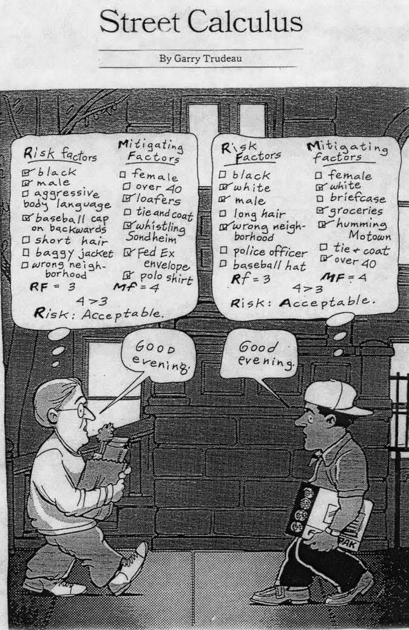
Risk as analysis and risk as feelings: Some thoughts about affect, reason, risk, and rationality. Slovic, Finucane, Peters, & MacGregor, Risk Analysis, 24, 2004.

Slide 48
New Measures: Risk Perception vs. Risk Attitudes
Weber & Bottom (1989) among the first to make this distinction
Perceived risk: ability to identify and integrate risks logically into cognitive evaluations
Good and Bad Risk Perceivers
Perceived Risk Attitudes: tendency to prefer choice options perceived to be more (less) risky
Risk Averse, Risk Neutral, or Risk Seeking
Option A
Option B
Notes:
Can we distinguish those who are “Once-bitten, Twice-shy”
Can we see what’s coming down the pike?
Between subject’s scaling assumes shared set of importance weights across individuals (e.g., regression weights of attitude scores used to predict future abuse/neglect

Slide 49
New Measurement: Risk Perception vs. Risk Attitudes
If differences in risk perception are the driving force behind differences in risk preference, then an effective mutual exploration of possible differences should focus on cognitive and perceptual variables; that is, information should be gathered about how the other party defines and perceives the riskiness of the choice options. If, on the other hand, differences in perceived-risk attitude are the driving force behind differences in risk preference, the focus of the exploration should be the other party’s affective response towards perceived risk (Weber & Hsee, 1998).
Affective responses color perceptions of risks and benefits (Alhakami and Slovic, 1994) which in turn influence risk taking, as shown in our studies. While not providing any direct evidence about mediating (cognitive or affective) processes, our scales allow for a functional analysis of differences in risk taking that goes further in providing explanations useful for interventions than any other existing approach. (Weber, Blais, & Betz, 2002, p. 283).

Slide 50
New Measurement: Risk Perception vs. Risk Attitudes
Domain-Specific Risk-Taking scale (Weber, Blais, & Betz, 2002; Blais & Weber, 2006)
Oklahoma to pilot vignette measure extending DOSPERT concept to maltreatment context
Similar to Parent Problem-Solving Measure (Hansen et al., 1989; 1995) and the Child Vignettes (Plotkin, 1983; Azar, 1989) measure
Broad topic coverage on 6 major subtypes of maltreatment
Medical Neglect, Environmental Neglect, Partner Violence, Physical Abuse, Emotional or Other Severe Neglect, and Substance Misuse

Slide 51
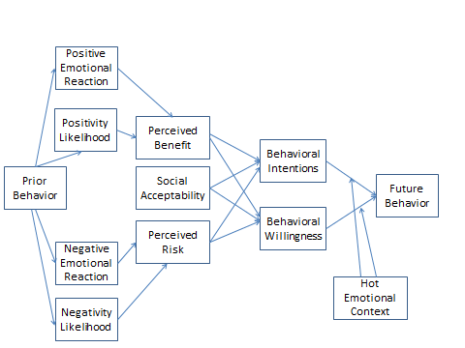
The New Frontier
Notes:
Do no want to leave behind the cognitive evaluation measures. We are working on an adapted version of the POQ, for example that more directly focuses on discipline strategies related to child development. Despite its loss of primacy in the new DM paradigm, cognition is still a strong predictor of behavior and perhaps our best defense clinically against hot-emotional risk-conducive situations. We intend to evaluate this in the coming years as part of our involvement with the federally funded MIECHV projects. Our aim is to test pieces of the displayed model above and in particular the relationship between

Slide 52
THANK YOU

